Slide 1
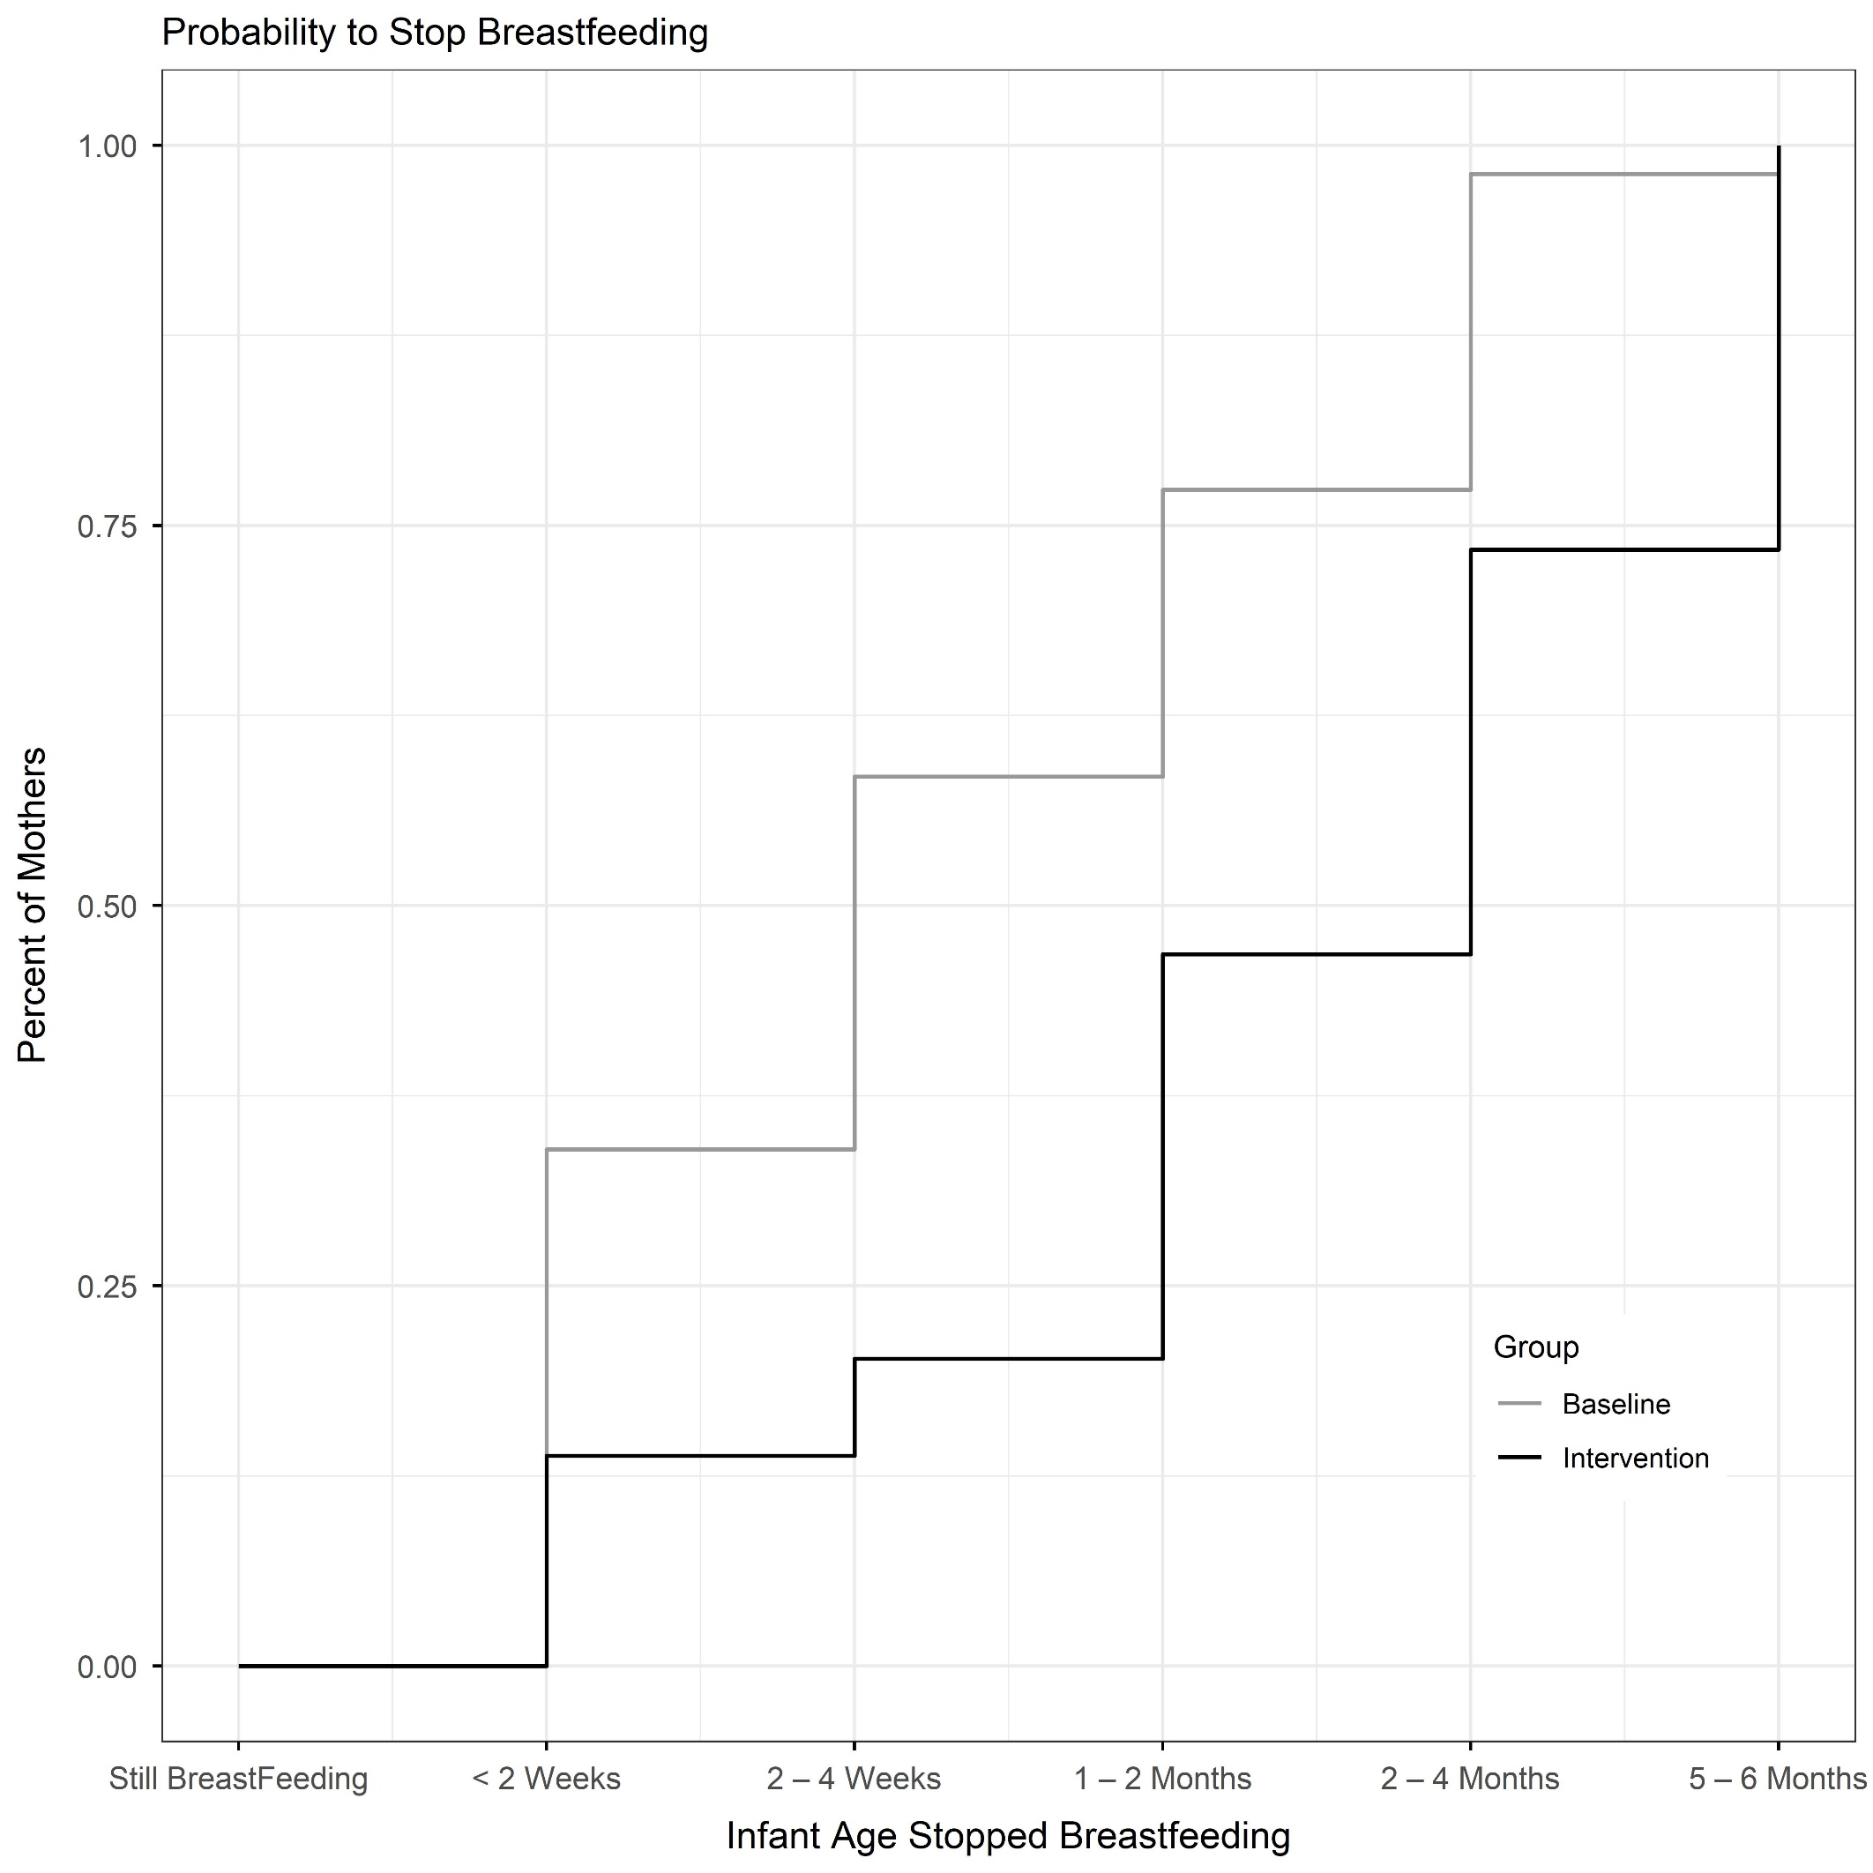
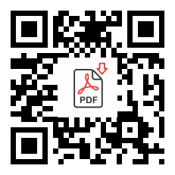
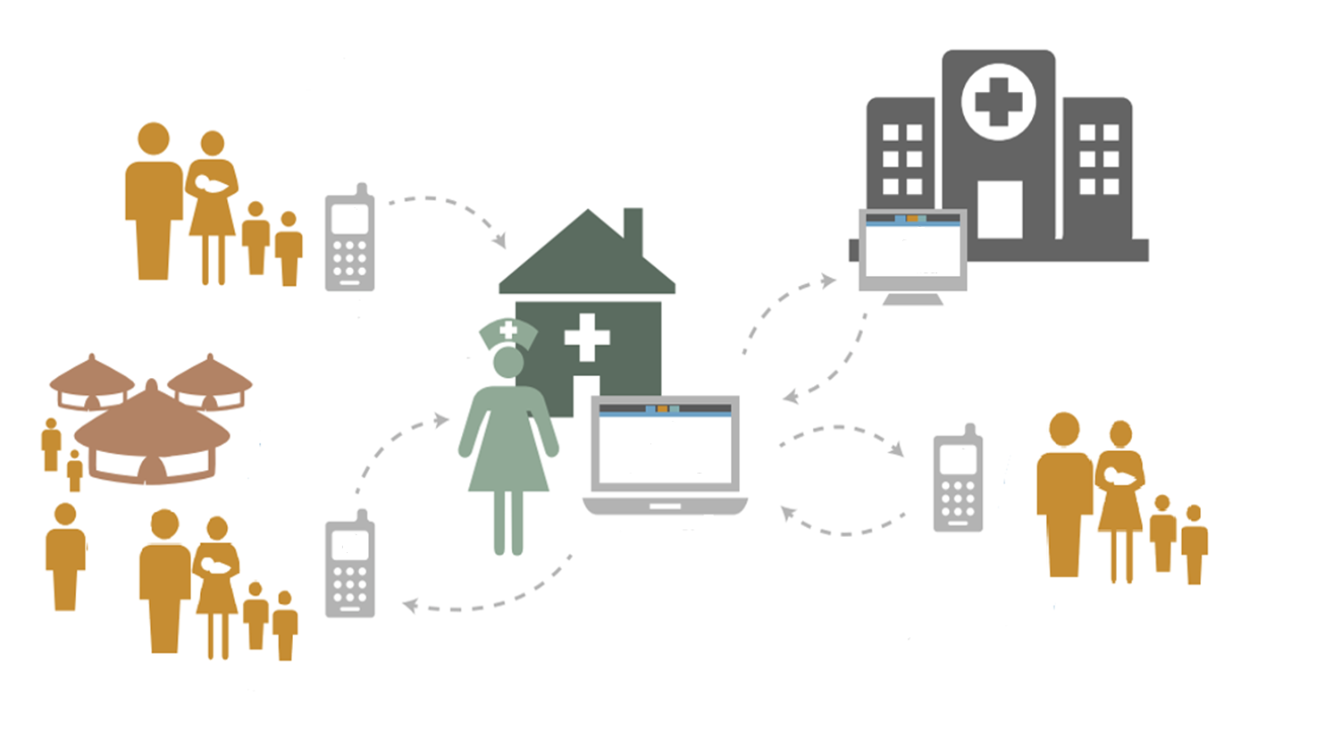




Using targeted client communication via mobile devices (TCCMD) to promote exclusive breastfeeding (EBF) in Roatán, Honduras
Results
EBF prevalence at 2 mos. and 4 mos. was 37.9% (I) vs. 13.6% (B) (p<0.0001), and 28.7% (I) vs. 13.5% (B) (p<0.05), respectively.
Odds of EBF at 2 mos. and 4 mos. were 4.2 and 2.3 times higher in (I) vs. (B), respectively (p<0.001, 95% CI[2.2, 8.1], p<0.03, 95% CI[1.1, 4.9]))
Decreased probability of stopping any breastfeeding in intervention vs. baseline group. See Kaplan-Meier Curve.
Mothers of young infants receiving text messages promoting exclusive breastfeeding (EBF) were MORE LIKELY to practice EBF at 2- and 4-months postpartum.
Andrew A. Yeung, MSII
University of California, Davis
Introduction
Promoting EBF is cost-effective and beneficial for both mother and infant; however, data on EBF prevalence in Roatán is limited.
Hypothesis
Will breastfeeding support through TCCMD ↑ prevalence of EBF for 2 mo. old infants in Roatán, Honduras?
Methods
08/16-05/17, a cross-sectional baseline survey of new mothers assessed EBF prevalence. (B)
09/17-11/19, an intervention recruited another sample of new mothers to receive 158 text messages promoting EBF over 6 mos. (I)
Data analyzed using Pearson’s chi-square test and student’s t-test
Discussion
EBF TCCMD showed statistically significant increased (1) EBF and (2) duration of any breastfeeding in first 4 mos. of infant life.
Cannot rule-out a temporal trend. Further study with a randomized trial would provide stronger evidence.
Mother Enrolled in Post-Partum Ward at Public Hospital Roatan
Take a picture
to download the full paper
UCD Support/ Data Management / Analysis
Survey sent to mother re: EBF at 2, 4 and 6 months of age
Questions: AAFYeung@ucdavis.edu
Encouraging and educational text messages sent to mother

